Slide 1
Premalignant lesions of the cervix/ cervical malignancy
Dr Rasika Herath
Department of Obstetrics and Gynaecology

Slide 2
objectives
Cervical screening
Treatment of premalignant lesions of the cervix
Cervical malignancy

Slide 3
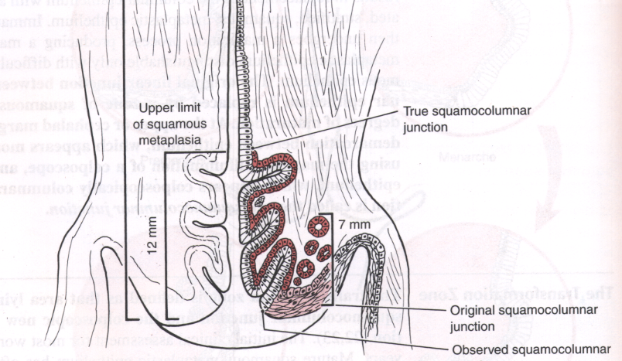
Anatomy of cervix

Slide 4
Normal
Pre malignant
Malignant
Pre malignant - Before the invasion of basal layer

Slide 5
Premalignant lesion of the cervix is called CIN/ SIL

Slide 6
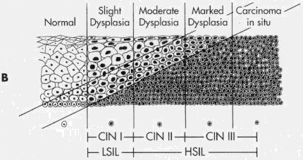
Squamous intraepithelial lesions

Slide 7
Risk factors of cervical cancer and premalignant conditions
Early age of sexual activity
Multiple sexual partners
Cigarette smoking
Immunosuppression
HPV infections

Slide 8
What is screening?
Screening is a public health intervention used on a population at risk, or target a population.
Screening is not undertaken to diagnose a disease, but to identify individuals with a high probability of having or of developing a disease.

Slide 9
Cervical smear
PAP smear
The cells are collected using a wooden spatula and the smear is prepared directly on the slide. The slide is then put into a jar containing alcohol.
Liquid based cytology

Slide 10
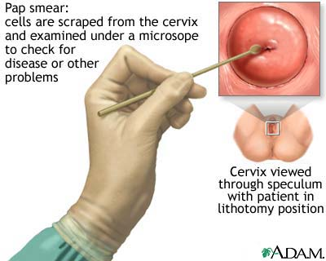

Slide 11
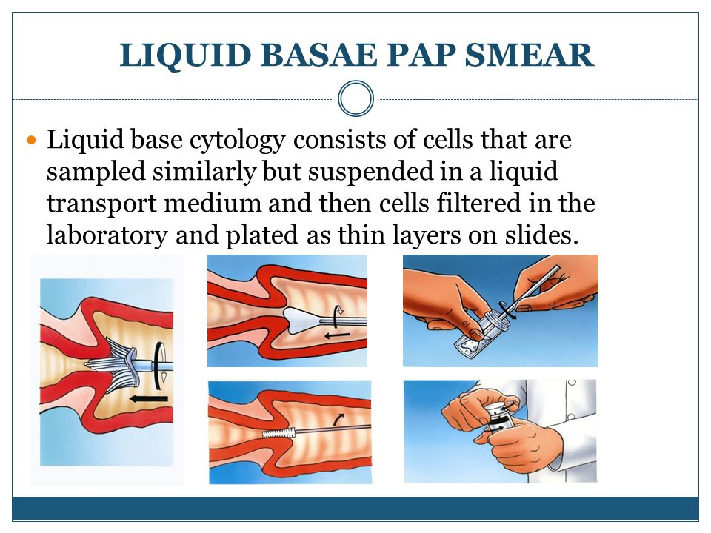
Liquid base cytology

Slide 12
HPV testing
HPV DNA of the cervical swab is tested
Can be done alone as a screening test or done in combination with cytology
It improves the sensitivity of detecting premalignant lesions

Slide 13
Classification of CIN
CIN / Bethesda
Refer
Pathology lecture

Slide 14
Management of abnormal smears
CIN 1 / LSIL
Repeat in 6 months
CIN 2, 3 / HSIL
Colposcopy and biopsy

Slide 15
Cervical smear
Unsatisfactory for evaluation
Satisfactory for evaluation
Repeat smear–correct the reason for unsatisfactory result
Negative for intraepithelial lesion
LSIL or ASC-US
HSIL or ASC-H for evaluation
AGC or malignant cells (squamous cell carcinoma or adenocarcinoma) or endocervical AIS
Repeat smear in 6 months to 1 year
Refer to hospital for further investigation and management
Refer for colposcopy and biopsy. Follow the standard management
Rescreen every 3 years for as per national policy
Normal
LSIL
ASC-US
HSIL
LSIL = low-grade squamous intraepithelial lesion HSIL = high-grade squamous intraepithelial lesion ASC-US = atypical squamous cells of undetermined significance ASC-H = atypical squamous Cells — cannot rule out HSIL AGC = atypical glandular cells AIS = adenocarcinoma in situ

Slide 16
Colposcopy
Next line of investigation for smear abnormalities.
low-power magnification and illumination of the low genital tract after applying various stains; acetic acid (3—5%).

Slide 17
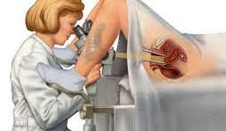

Slide 18
Colposcopy procedure
Cervix is examined under magnification
Observe for abnormal vascular patterns
Classical appearance of punctation and mossaicism indicate CIN
Bizzare-shaped vessels suggest a cancer.

Slide 19
Colposcopy procedure
Acetic acid is then applied to the cervix.
Areas of CIN is will appear as varying degree of whiteness. This is termed aceto-whiteness.
Biopsies from the acetowhite areas will give a histological diagnosis.

Slide 20
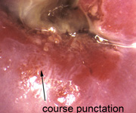
Punctation at colposcopy

Slide 21
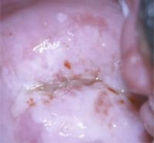
Dense acceto-white lesion

Slide 22
Biopsy result
Normal
Condyloma/CIN 1
Adenocarcinoma
In situ
Invasive cancer
CIN 2/CIN 3
Repeat cytology/colposcopy at 6 months*
Treat with cryotherapy or LEEP or cold knife conization
Cold knife conization
Normal
Progression
Repeat screening test every 3 years
(Or as per national policy
Follow up at 6 and 12 months after treatment. Evaluate with colposcopy and cytology (cervical biopsy, endocervical curettage if abnormal)
Manage with oncologist
Normal
Persistent or progressive disease
Repeat screening annually for 5 years, then return to normal screening programme**
Re-treatment
*If the lesion persists, the colposcopy should be repeated every 6 months until regression or progression occurs
**In case of CIN1 or CIN2, reyurn to normal screening programme after 1 year

Slide 23
Treatment of histologically confirmed CIN/SIL
Treatment of CINSIL can be either
ablative ( destroying)
Excisional ( removing)

Slide 24
Ablative methods
Before using any form of ablative therapy, histological diagnosis by colposcopically directed biopsy/biopsies should be done

Slide 25
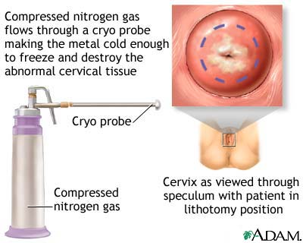
Cryocautery
It destroys tissue by freezing using probes of various shapes and sizes, and is probably best reserved for small, low-grade lesions

Slide 26
Other ablative methods
Use of electro-diathermy
Laser ablation

Slide 27
Excisional methods
Transformational zone can be excised surgically to achieve cure
It can be done with a diathermy with a loop or with scalpel

Slide 28
Excisional methods
LLETZ ( large loop excision of the transformation zone )
Using a wire loop / diathermy
Cone biopsy
TAH

Slide 29
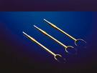
LLETZ
LLETZ ( large loop excision of the transformation zone )
Uses a wire loop to excise a part of the cervix with the transformation zone.
It is performed under general /local anaesthetic.

Slide 30
Cone biopsy of the cervix
A cone of cervical tissue is removed from the cervix to involve the transformational zone
Comparatively increased risk of haemorrhage, fertility and pregnancy morbidity comparable to LLETZ.

Slide 31
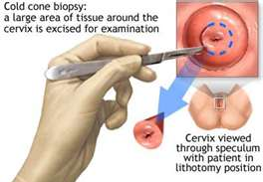
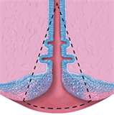
Cone Biopsy of the cervix

Slide 32
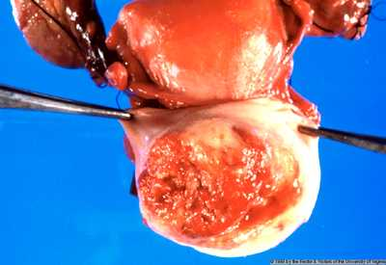
Cervical carcinoma
Growth in the cervix completely obliterating the cervical opening

Slide 33
Commonest gynecological malignancy
Squamous cell carcinoma: 85 %
Adenocarcinoma : 15 %

Slide 34
Invasive cancer of the cervix
Pattern of spread
By direct spread into the cervical stroma, parametria and beyond, into the vagina, the bladder and rectum
By lymphatic spread into parametrial, pelvic sidewall and para-aortic nodes.

Slide 35
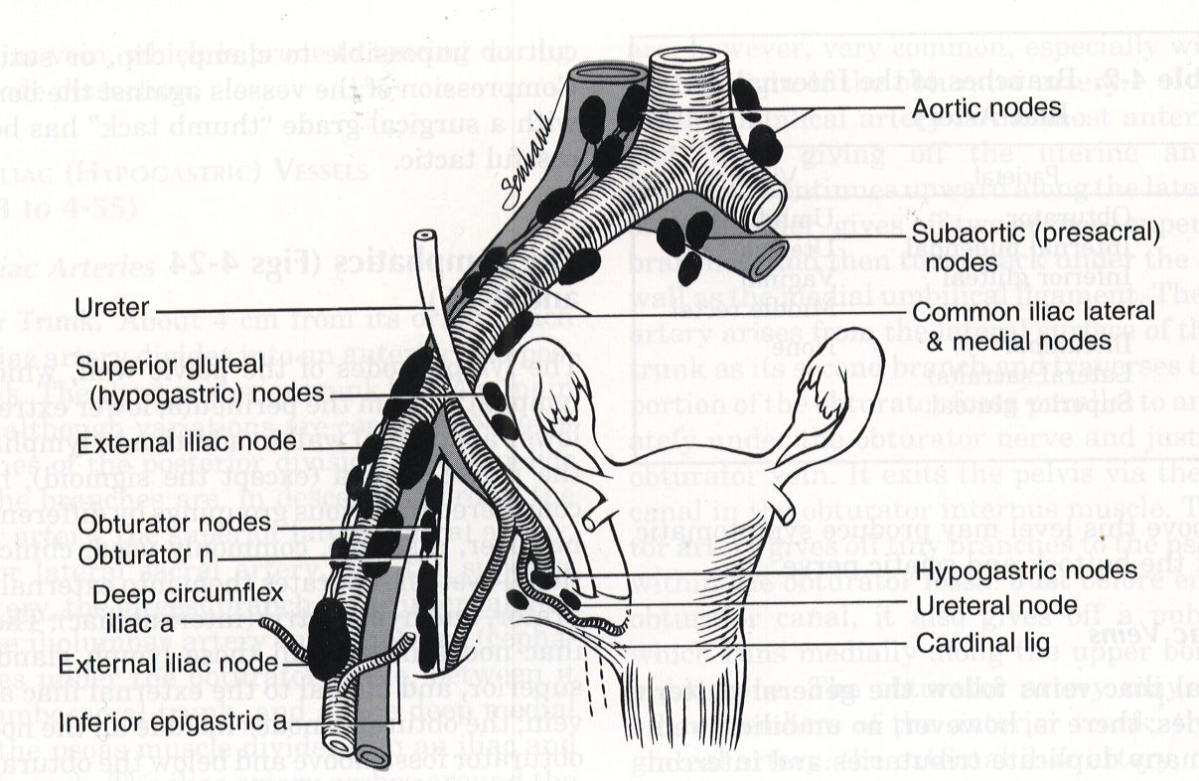

Slide 36
Clinical features
Abnormal vaginal bleeding
Irregular bleeding
Inter menstrual bleeding
Post coital bleeding
Post menopausal bleeding
Vaginal discharge
Necrosis : Irritant fishy odor
Secondary infection : Purulent

Slide 37
Malaise, Cachexia, Anaemia
Nerve pain
Obturator nerve in the lateral pelvic wall - Pain over upper thigh
Backache - Sacral plexus & nerve root involvement
Leg oedema
Lymphoedema : Involvement of lateral pelvic wall
Deep vein thrombosis ;

Slide 38
Bladder symptoms
Frequency
Urgency
Dysurea
Vesico- vaginal fistula formation - later
Bowel symptoms
Tenesmus
Bleeding per rectum
Recto vaginal fistula formation - later

Slide 39
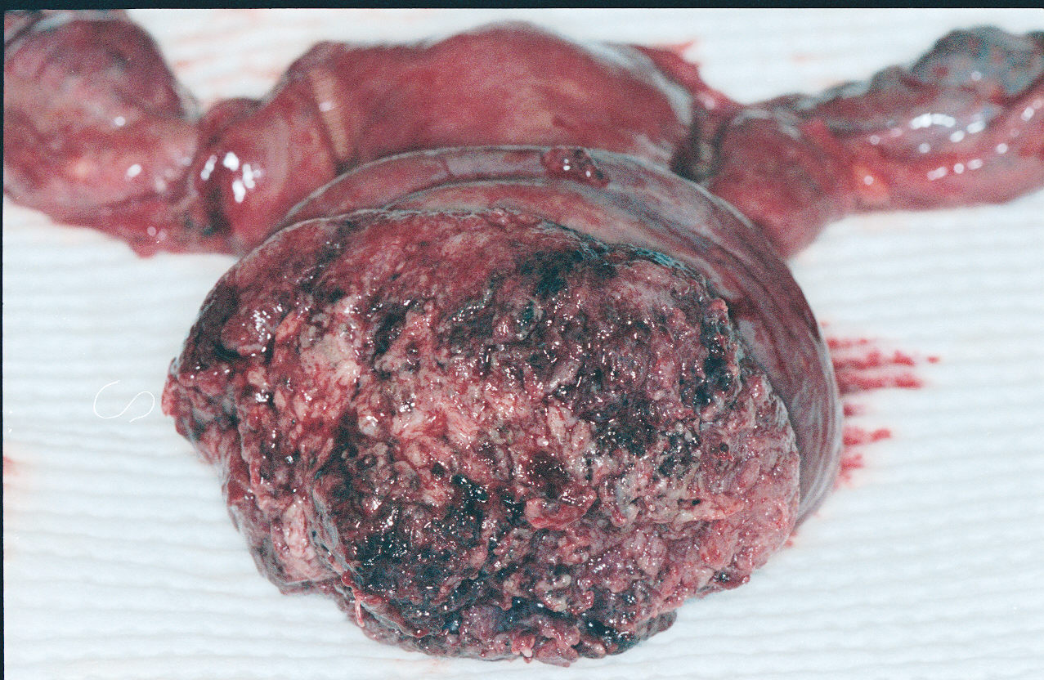

Slide 40
Confirming diagnosis
Examination under anaesthesia
Biopsy of the lesion

Slide 41
Staging procedures
Clinical staging at examination under anaesthesia
MRI

Slide 42
1 Confined to the cervix
1a - Microscopic lesion
1b - Clinical lesions confined to the cervix
11 lesion extends beyond cervix
11a - Involving upper vagina
11b - Involving parametrium not up to the pelvic wall
111 further spread in to vagina & parametrium
111a - Involving lower1/3 vagina
111b - Involving parametrium up to the pelvic wall (includes non functioning kidney)
1V Beyond true pelvis
1Va - Involving bladder and rectum mucosa
1V - Spread to distant organs

Slide 43
Treatment
Stage 1 a 1 disease
Maximum depth of invasion is 3 mm
TAH would be adequate
1a2, 1b, and 11 A
Radical hysterectomy and pelvic node dissection
11b and above ; radical radiotherapy / chemo-radiotherapy

Slide 44
Radical hysterectomy and pelvic node dissection
Total abdominal hysterectomy
Parametrium with adequate tumour free margin
Pelvic lymphadenectomy ( common iliac, internal and external iliac, obturator)
Cuff of the vaginal

Slide 45
Chemoradiation
Radiotherapy combined with radiotherapy
Given concurrently
Cysplatin based therapy
Indicated if
Stage is 11b and above
Positive lymphnodes after radical hysterectomy
Excision margin is < .5 cm

Slide 46
Chemoradiation
Cysplatin based therapy
Given concurrently with radiation

Slide 47
Read about
Prognosis of cervical cancers
Prognostic factors
Complications of radiotherapy for cervical malignancy

